Slide 1
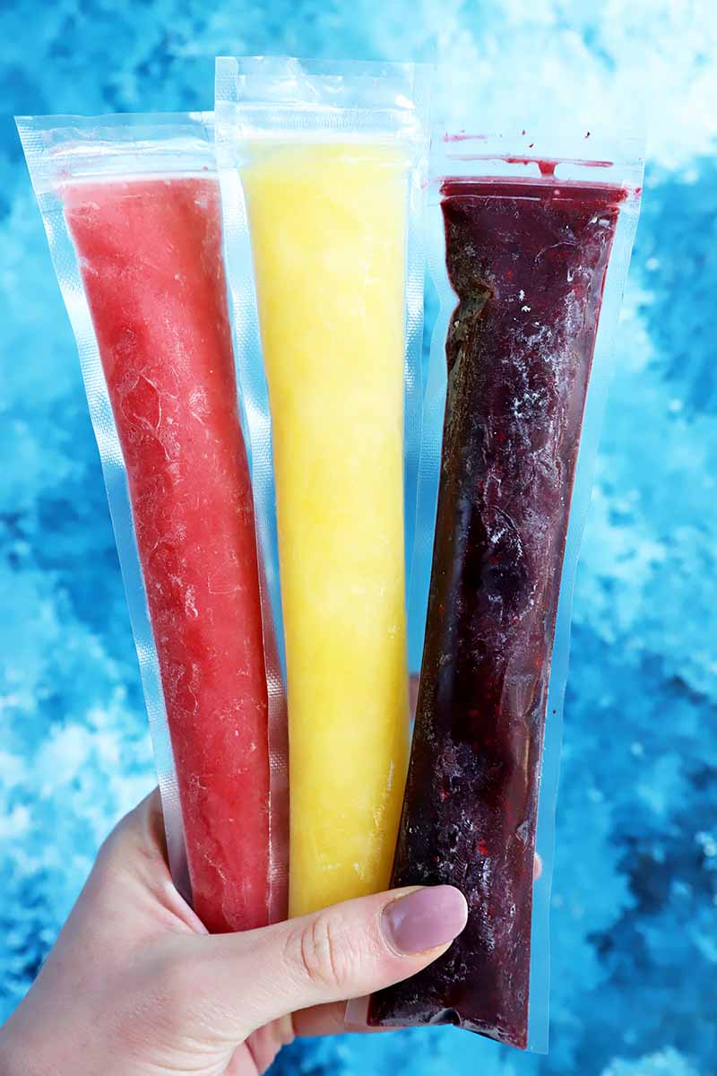
Feeling Nostalgic, Right?
Do you want to live your childhood again?

Slide 2
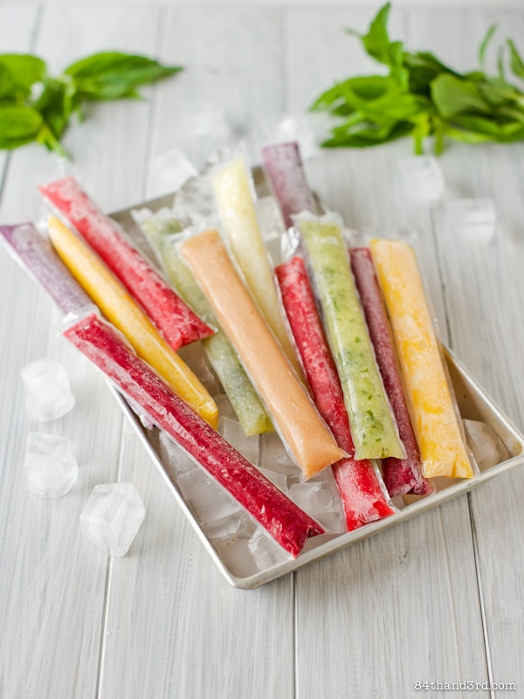
Colored Ice pops are inseparable to our life. But those Ice pops are not available right now. In some places, it is available but those are not good for health.
Then, can’t we live with that moment again?

Slide 3
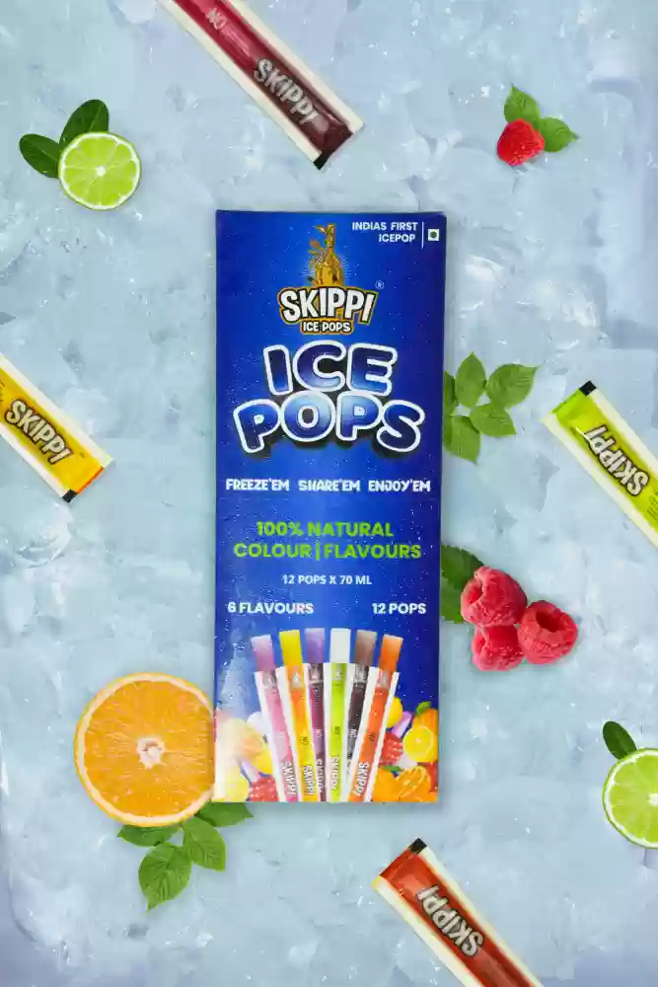
Off course, we can.
We have brought India’s 1st & only Ice pops brand “SKIPPI Ice Pops” for you.

Slide 4
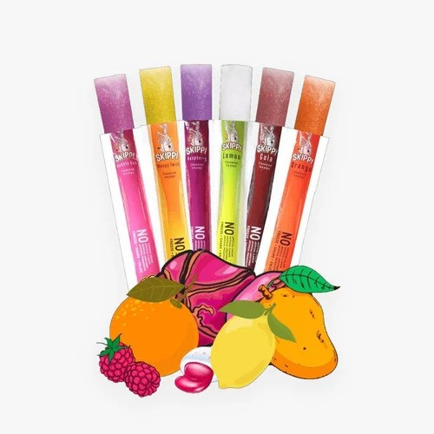
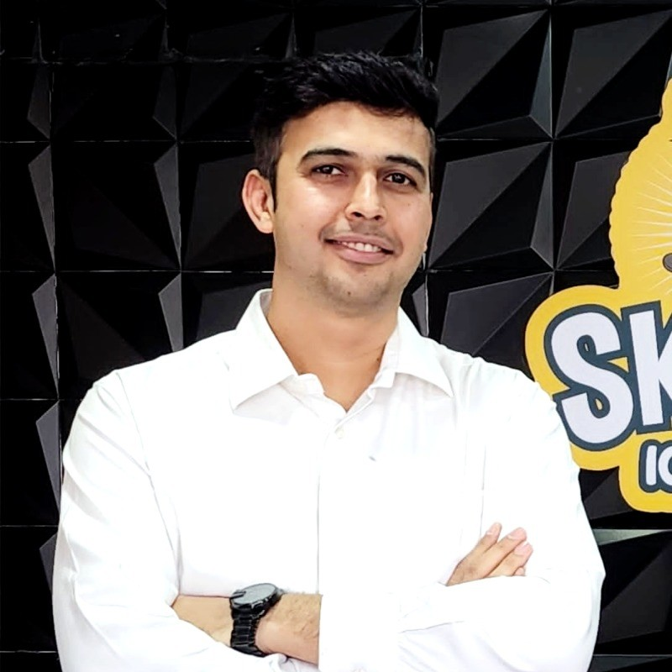
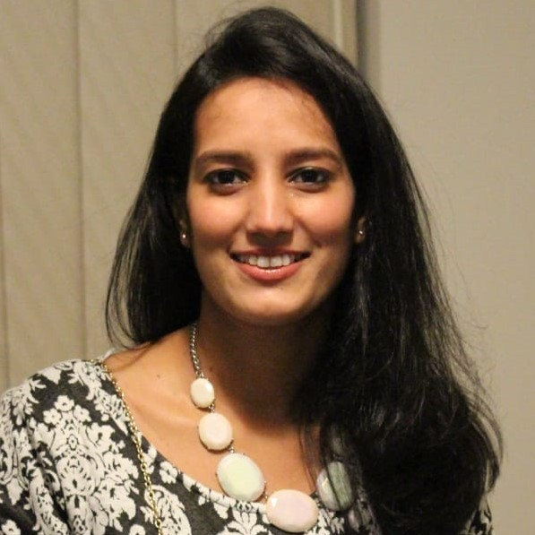
Meet People
“SKIPPI Ice Pops” is a Hyderabad, India based Ice Pops Brand & founded & operated by-
Ravi Kabra
Co-founder
Have worked in food & beverage industry in the last 17 years where he did re-packing in small sizes.
Anuja Kabra
Co-founder
Have over 14 years of experience in F&B space. Expert in compliance and new product developments (NPD’s).

Slide 5
Product Features
100% natural color (Extracts from fresh fruits & vegetables)
Natural Flavor
Natural Preservatives
Natural Sweetener
6 Flavors available: Raspberry, Orange, Mango Twist, Bubblegum, Cola, Lemon
Attractive Packaging

Slide 6
Distribution
In India, the supply of the frozen goods is very difficult to execute. That’s why, we removed the refrigeration from the whole supply chain.
It is made in liquid form & in a room’s temperature. Then, we supply this to our retailers & distributors, maintaining the room’s temperature.
After buying, Customers freeze it & ENJOY!

Slide 7
Market Size
India market size: The market size is 450 million in India.
Global Market Size: Due to the COVID-19 pandemic, the global Ice Pops market size is estimated to be worth USD 5003 million in 2021 and is forecast to a readjusted size of USD 7261.1 million by 2028 with a CAGR of 5.4Percent during the forecast period 2022-2028. Some global players are Nestle, Unilever, Yili, Mengniu, Akagi Nyugyo, Meiji, Daqing Ruby Ice Cream, Lotte, Jel Sert, Jinan Qunkang, Alamance Foods, GoodPop, Chloe's Fruit, Mr. Freeze, Deebees where as Nestle, Unilever & Yili hold a market share about 52Percent.

Slide 8
Target Audience
Kids but first customers are of 25+ years of age. When they feels the experience, then they take them for their kids. Once it reaches to kids, then repeat orders is inevitable.

Slide 9
Criticism & Defense
Though this is sugar water which is unhealthy but the founders consider it as a fun product. It brings excitement & fun to the kids & elders & also connects people back with the old memories.
There is also a very big market for unhealthy products.

Slide 10
Vision
Currently, it is a Hyderabad based ice pop brand. Within next 3-4 years, I want to make it a national brand & then will take it to the international. They know the value the company has in Middle East & Africa. Indian cricket team should carry skippi on their T-shirt due to patriotism & the target market which is 25+ year olds who loves cricket.

Slide 11
Accounting Numbers
Sales till date, last year 46 lacs, last month 7 lacs.
Gross Margin ….%
Net Margin ….%

Slide 12
Unit Economics
Selling price is 20 rupees
Cost of making (Including primary & inner packaging & carton cost) is 5 rupees
Sell it to the wholesaler @13 rupees

Slide 13
Competitive Advantage
The soft ice you get, is not possible with the available technologies. We have that technology & we patented that to protect the quality that customers are enjoying right now.

Slide 14
Ask | 45 lac rupees for 5% equity i.e. 9 crore valuation
Usage | The fund will be used for marketing & branding
Reason | The business is generating enough cash flow & the founders are able to finance personally for the current need. Because they believe that the investors can add more value to the business by bringing their expertise on the table.
Prior Investor Information | There is no prior investor till date. The business is financed by founders i.e. totally bootstrapped. They invested 55 lacs rupees in this business.

